Slide 1
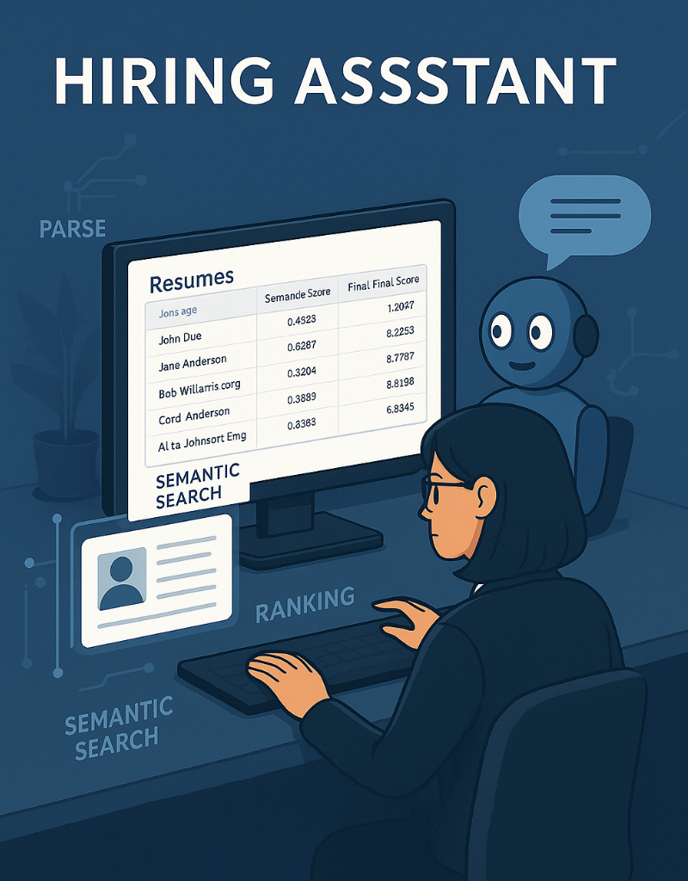
Hiring Assistant BCIS 5140 Term Project - Spring 2025
Team members:
Trisha Chandur Pavani Konka Alekya Bollina Harshitha Sreiya Palaparthi

Slide 2
Executive Summary
To: Hiring Team, TechCorp Solutions
From: Trisha Chandur, Group3
Date: 4/25/2025
RE: Proposal for an Agentic AI Resume Screening System
Dear Mr./Ms. Director of Application Development
This project addresses inefficiencies and bias in traditional hiring pipelines, most commonly caused by rigid ATS filters and recruiter subjective screening.
We believe in light-agent, reduced-configuration AI architecture that screens, ranks, and justifies candidate matches on an Retrieval-Augmented Generation (RAG) approach.
The Hiring Assistant builds a rubric from scratch from job descriptions, semantically matches candidate resumes through vector embeddings, and sorts candidates by a hybrid score of semantic appropriateness and rubric alignment. A dynamic agent retrieves analyzed resume context which it reasons upon and communicates using an intelligent chatbot to interact with recruiters for real-time question answering and rubric modification through direct recruiter feedback. The system gets better with continuous improvement because the feedback loop operates in a closed system that adapts with each passing second.
The answer rests on an in-house, offline design, relying on a quantized version of the Mistral-7B-Instruct model for efficient computation independent of cloud API usage. The stack involves Streamlit as UI, PyMuPDF to parse resumes, Sentence Transformers to produce semantic embeddings, in-memory vector similarity search to perform matching, and Pandas for hybrid scoring through the combination of budget-friendly open-source tools with adaptive AI reasoning capabilities the Hiring Assistant actively enhances recruiter confidence and shortens selection periods and minimizes human prejudices to deliver superior candidate assessment results.
Our team has faith that Tech Corp Solutions will benefit from this Hiring Assistant system while achieving its innovation targets alongside optimized recruitment process configuration through an intelligent adaptive platform configuration.
Sincerely,
Trisha Chandur
Trisha Chandur

Slide 3
PROJECT OVERVIEW

Slide 4
Our Understanding of your Business Needs
About the client
Tech Corp Solutions functions as a leading technology organization that specializes in developing software, cloud-based technology, and AI solutions. The company employs more than 5,000 personnel distributed across its multiple locations to deliver innovative technology solutions that help enterprises in digital transformation. Tech Corp strives to hire and retain highest-grade employees for positions like software engineers, data scientists, and cloud architects. The recruitment posts receive more than 500+ candidates, and the traditional way of hiring proves to be non-effective due to time consumption for screening, biased selection processes, and wastage of candidate leads. TechCorp needs an AI recruitment tool to support its competitive hiring mode using fair and authentic methods of hiring high-grade candidates
About the business need
Engaging the optimal talent on punctual and streamlined terms is crucial to upholding operational dominance at
TechCorp Solutions. Standard recruitment protocols that rely immensely on manual review of resumes and strict
Applicant Tracking Systems (ATS) are greeted with harsh hurdles:
Inefficiency: Manually screening resumes to a tremendous degree is executed, which uses an absolute bunch of recruiter time and turns dreadfully slow.
Subjectivity and Bias: The hiring decision is vulnerable primarily to human nature and therefore more prone to unconscious discrimination and arbitrary decision making.
Limited Adaptability: Historical systems are not possible to establish in an adaptive manner and provide dynamic answers to filtering demands from changing work needs or recruiter feedback.
Opaque Decision-Making: Recruiters and hiring managers often cannot supply clear, explainable reasons for candidate selections, reducing confidence in automated decisions.
Competitive Pressure: In a competitive job market, delayed hiring or subpar screening processes can lead best candidates to the competition. To reverse such challenges, TechCorp Solutions requires an intelligence-enhanced, quicker, more agile recruitment process that facilitates recruiter productivity, accelerates and balances decisions in hiring, and increases transparency along the path of making judgments. The solution now must combine AI-supported logic with human judgment to optimize decision quality without sacrificing agility for credibility.

Slide 5
Project Goal and Outcomes
Goal of the project
The project aims to develop a light-agent powered by RAG which will improve TechCorp Solutions' resume screening processes and candidate evaluation activities with local offline AI reasoning functionality.
Specifically, the project aims to:
We will develop an AI system which uses its agency to access dynamic candidate-job fit information then process it into actions.
The application uses PyMuPDF to transform job descriptions as well as resumes into structured text files in local storage.
The system performs candidate-job requirement matching through in-memory vector search together with Sentence Transformers embedding.
The system will create a combined candidate ranking that combines semantic comparison results with skill ratings produced by the rubric method.
The system allows dynamic recruiter feedback using an offline chatbot which relies on a quantized Mistral-7B model for operation.
The system delivers a transparent explanation of its evaluation methods by using Streamlit interface software.
The Hiring Assistant functions independently offline and locally to provide secure and budget-friendly candidate assessment processes that remain flexible.
Intended outcomes
The Hiring Assistant system provides TechCorp Solutions with the following advantages:
Speedier Hiring: The combination of resume parsing and semantic matching and automated candidate ranking systems lets the organization reduce time-to-hire durations.
Enhanced Candidate Evaluation The combination of semantic relevance with rubric-based scoring provides candidates with clear explanation of their ranking position.
Recruiter Feedback Flexibility: Allow real-time rubric updates from hiring manager feedback through a local RAG-driven chatbot.
More Recruiter Confidence: Allow recruiters to see, control, and shape the evaluation process in real-time.
Scale-Out and Modular Structure: Facilitate future scale-up to larger datasets, better vector search without having to redeploy base infrastructure.

Slide 6
Project Scope, Constraints and Assumptions
Scope of the project
The proposed system uses AI technology to build a Hiring Assistant which will strengthen both resume evaluation and candidate assessment at TechCorp Solutions through local offline operation.
A light-agent RAG-based system operated fully locally and offline builds the candidate evaluation process at TechCorp Solutions by ensuring privacy and cost effectiveness and data control.
The scope includes:
Resume and Job Description Parsing:
Parse semantically-structured text from PDFs using PyMuPDF.
Semantic Embedding and Matching:
Utilize Sentence Transformers to obtain semantic embeddings and in-memory vector similarity search to match candidates against jobs.
Hybrid Candidate Ranking:
Join semantic similarity-based scores with skill-scoring data obtained from rubrics using Pandas to deliver transparent, actionable candidate rankings.
Rubric Development and Dynamic Adjustment:
Load the starting skill-weight rubric and activate recruiter-initiated real-time modification through chatbot interactionI
Interactive Chatbot:
Invoke an instruction-tuned Mistral-7B-Instruct (quantized, local model) for answering recruiter questions, generating candidate explanations, and updating rubric parameters dynamically.
Recruiter-Facing Interface:
Implement a web application with Streamlit for easy selection of job descriptions, resume marking, ranking visualisation, and chatbot dialog.
Local and Offline Operation: All parsing, matching, reasoning, and chatbot interactions are performed solely on local infrastructure with no need for internet access, external cloud computing, or commercial APIs.
Current Evaluation Scope: The system is also designed to be capable of handling evaluation against a single job description in the first prototype.
Future Scalability: Though the existing system is designed for local deployment, it is designed to be future-proof for migrating to vector database-as-a-service or managed LLM services when scaling demand requirements are needed and also integrate with ATS system

Slide 7
Project Scope, Constraints and Assumptions
Project Deliverables
Deliverable Name | Expected Content | Deliverable Description | Due Date
Pitch Presentation | Project idea summary, business need, proposed solution, anticipated outcomes, tech stack | Presentation Day | February 25, 2025
Interim Report and Design Walkthrough | Details of the system design, architecture diagram, description of technology stack, first progress report | ~45 days | February 25–April 11, 2025
Project Development Phase | Entire system implementation: parsing resume, semantic matching, hybrid ranking, RAG chatbot, UI integration | ~18 days | April 11–April 29, 2025
Final Presentation | Entire project demonstration, anticipated outcomes accomplished, summary of the system, challenges encountered, and future development concepts | Presentation Day | April 29, 2025

Slide 8
Project Scope, Constraints and Assumptions
Limitations Constraints and Assumptions
Limitations:
•Supports evaluation against one job description at a time. •No integration with external ATS systems or candidate communication. •No psychometric or behavioral analysis. •It runs vector search operations from memory whereas it does not use external vector databases. •This system functions exclusively within a single computer without internet access as it was not created for multiple-user cloud-based collaboration.
Constraints:
Formatted PDF text files must be handled by appropriate formatting, but text extraction can differ depending on formatting problems in the tasks.
The solution works optimally when handling datasets of a small to mid-size range size although it will take extended optimization to continue boosting capabilities.
•The inference process using CPU-optimized quantized model might require enhancement for handling large datasets effectively. Assumptions: •Recruiters manually select job descriptions. •The system supports only text-based PDFs as input and assumes administrators did not use OCR. •The system directly extracts skills from the text content. •The system accepts feedback through basic text input.

Slide 9
Future Scope – ATS Integration
Current Implementation
The current system functions as a standalone local platform which accepts resume and JD uploads through Streamlit interface.
The system implements three modules through PyMuPDF for parsing and SentenceTransformers for embedding along with Pandas for ranking.
Agent Design:
The system processes information while using RAG for reason-based understanding before performing ranking operations to generate adaptations through its chatbot platform.
LLM: Quantized Mistral-7B-Instruct via ctransformers, fully offline.
The RAG-based chatbot functions through integrated resume and JD data and rubric information.
Why Integrate with ATS?
The system should remove human dependency from uploading JD/resume documents by implementing automation.
The ATS recruiter workflow incorporates direct embeds of assistant result outputs.
The system supports working with numerous roles and processes a high number of applicants.
Provide explainable, real-time hiring support.
How It Can Be Achieved
REST API interfaces should wrap all assistant modules including parsing algorithms and ranking processes and chatbot functions.
The system accesses ATS Application Programming Interfaces to obtain and deliver data from platforms like Greenhouse and Lever.
Use webhooks/polling to trigger workflows.
Integration of chatbot and rating user interface capabilities within ATS software solution employs iframe/plugins technology.
ATS should receive both rubric assessments and ranking feedback.

Slide 10
PROJECT APPROACH

Slide 11
Project Approach
Why Agentic AI
We created an Agentic AI architecture to build a goal-oriented Hiring Assistant that operates flexibly rather than rigid rule-based flows. The AI in an Agentic system operates similarly to a goal-oriented assistant: it retrieves facts, reasons on context, and acts dynamically prompted by user input — reflecting the natural workflow of recruiters.
Our approach combines a Light-Agent framework, where one agent performs the following:
Retrieving parsed job description and resume context,
Reasoning for candidate fit using semantic matching and rubric-based scoring,
Dynamic acting by reacting to recruiter questions and dynamically adapting evaluation criteria using a RAG-driven chatbot
The agent performs all the reasoning, retrieval, and interaction locally and offline, preserving data privacy, cost-savings, and cloud independence
Benefits of Agentic Architecture for this Project:
Dynamic flexibility: The system is trained via recruiter feedback (dynamic rubric updates).
Task flexibility: The agent reads, reasons, ranks, and changes evaluation without being hard-coded.
Explainability and transparency: All decisions (ranking, explanation, rubric modification) are context-dependent and open to recruiters.
Efficiency: A single Light-Agent design may enable faster development and simpler maintenance than complex multi-agent deployments.
Local and Offline Mode: Complete deployment locally enhances the privacy of the data, curtails operating expenditure, and eradicates reliance upon cloud infrastructure. With Agentic AI, not only does the Hiring Assistant filter resumes intelligently but also converse with human recruiters to build a wiser, adaptive, and personal hiring process.

Slide 12
Project Approach
Agentic AI Architectures
Agentic AI designs construct AI systems as goal-directed agents able to retrieve information, reason about context, make decisions, and change action dynamically based on current inputs. Unlike rigid rule-based processes, agentic systems operate in a flexible manner, adjusting actions according to goals and evolving user feedback.
The main features of Agentic AI architectures are:
Relevant information retrieval,
Decision-making by reasoning over information,
Flexibility based on new inputs or evolving conditions.
Architectures may vary from:
Light-Agent Systems: One agent performs all tasks — retrieval, reasoning, action — which simplifies the system, makes it quicker to develop, and maintain.
The Multi-Agent Systems architecture combines several specialist agents who handle different subtasks including searching and planning knowledge updating. A Light-Agent system within the Hiring Assistant project handles candidate context collection and resume ranking and delivers recruiter chat assistance through a RAG-powered bot and adjusts assessment rules. Every operational task functions independently without requiring online or internet connectivity. The evaluation system maintains its private nature and continues to be cost-efficient and flexible while operating independently from external cloud-based services.

Slide 13
Project Approach cont’d
Data sources and integration requirements
Job Descriptions: Uploaded as PDFs into the job_descriptions/folder, parsed locally for skills and role context.
Candidate Resumes: Uploaded as PDFs into the resumes/ folder, parsed locally for experience and skill extraction.
The rubric json file located in the rubric/ folder determines skill-weight mappings that guide evaluation while the CPU-optimized quantized model requires an upgrade to handle large datasets effectively.
Integration Requirements
Local Data Management: All data processing (uploading, parsing, embedding, matching) is performed locally and offline through structured folders; no cloud services, APIs, or databases are used
Parsing and Embedding: Py MuPDF is utilized to parse PDFs, and Sentence Transformers are utilized to generate semantic embeddings to enable in-memory similarity matching.
Context Building: Internally, resume text content, job description content, and rubric data are blended into the grounding context for the local RAG-powered chatbot.
Single JD Evaluation: The system currently supports evaluation against a single job description at a time.

Slide 14
Project Approach cont’d
Success metrics and evaluation plan
Success Metrics
Resume Parsing Accuracy: Retrieve text correctly from at least 95% of resumes and job descriptions.
Semantic Matching Relevance: Top-ranked applicants should closely match job requirements, as verified by manual validation.
Rubric Matching Effectiveness: Correct skill identification and grading in ≥90% of cases by recruiter assessment.
Chatbot Interaction Quality: High Q&A answer quality and rubric refresh with ≥90% recruiter satisfaction
Evaluation Plan
The parsing accuracy must be verified through direct comparison between output files and original PDFs.
An examination of candidate rankings must be conducted manually to ensure semantic agreement with the provided assessment rubric.
The validation process includes using predefined queries together with rubric update tasks to evaluate chatbot responses.
. The team should gather recruiter feedback regarding both system user experience and rating transparency and chat interface performance.
The final report together with the presentation should present findings and success rates.
The testing phase will operate offline while evaluations run locally to guarantee privacy of the data throughout testing activities.

Slide 15
SOLUTION REQUIREMENTS

Slide 16
Business requirements – Stakeholder analysis
Stakeholder | Role | Business Need/Expectation
Recruiters / Hiring Managers | End Users | Effective resume evaluation, open candidate scores, and flexible rubric refinements .
Project Sponsors | Oversight | Effective deployment of an AI-based hiring tool improving speed, equity, and quality.
Technical Team | Developers | Build sustainable architecture via parsing, embeddings, hybrid ranking, and RAG chatbot integration.

Slide 17
SOLUTION DESIGN

Slide 18
Business requirements – Agentic Solution Environment and Objectives
Agentic Solution Environment
The Hiring Assistant uses Light-Agent architecture combined with the Retrieval-Augmented Generation
(RAG) approach for its foundation.
RAG approach.
The system runs through an optimized modular setup designed to work locally with offline capabilities.
offline, ensuring privacy, cost-efficiency, and full control over data.
The environment consists of:
Data Sources:
All Job Descriptions in PDF format exist within the job descriptions/ directory.
All PDF documents and Candidate resumes find their storage within the resumes/ directory.
The JSON form of the rubric remains stored in the rubric folder.
Embedding and Retrieval:
The system converts the semantic embeddings of resumes along with JDs through SentenceTransformer (all-MiniLM-L6-v2).
The system implements in-memory vector similarity search to determine the semantic relevancy between the Candidate resumes and job descriptions. Job descriptions without external database dependency.
Reasoning and Generation:
The Mistral-7 B-Instruct model uses a quantized version 7 with an instruction capability to supply context-based answers regarding employment candidates.
A local RAG-based chatbot performs candidate ranking tasks and dynamically updates evaluation criteria using the Mistral-7 B Instruct the model.
User Interaction:
The system allows recruiters to engage with the interface built from Streamlit, which enables them to make
job The user interface allows recruiters to view ranked candidates as well as refine evaluation criteria with
help from a chatbot system.
The Hiring Assistant environment exists as a locally deployable offline system according to its design specifications.
Reliance on paid LLM services. The implementation guarantees improved data security with efficient operation and growth potential for expanding organizational capabilities.

Slide 19
C
Agentic Solution Objectives
The Agentic Hiring Assistant has the below primary targets:
Retrieve relevant information:
The system within retrieves resume-related info along with job description data as well as the rubric data from an internal storage. It functions from local storage.
Reason intelligently:
A cross-method rating approach allows candidates to be evaluated against job positions by conducting a semantic analysis with a Rubric score evaluation.
Adapt dynamically:
The evaluation system with its rubric weights needs adjustments that recruiters can make while participating in recruitment operations.
Act on goals:
The system generates candidate rankings supported by detailed explanations, along with the capability to answer recruiter questions that use an integrated informational request feature combined with local RAG-powered chatbot functions. Recruiters can use integrated informational requests. Through an integrated local RAG-powered chatbot.
Enhance hiring workflows:
The AI system needs to enhance screening time efficiency and produce clear optimization results that improve workflow. The assessment technique operates as specialists do when evaluating people.
Industrial control functions and privacy operations are performed locally offline to exclude costly needs and ensure fast responses without depending on the cloud.
A goal-driven design structure enables the Hiring Assistant to show operational adaptability while performing self-evolution throughout real-time operations. This system serves recruiters in their talent acquisition optimization efforts with significant, meaningful support

Slide 20
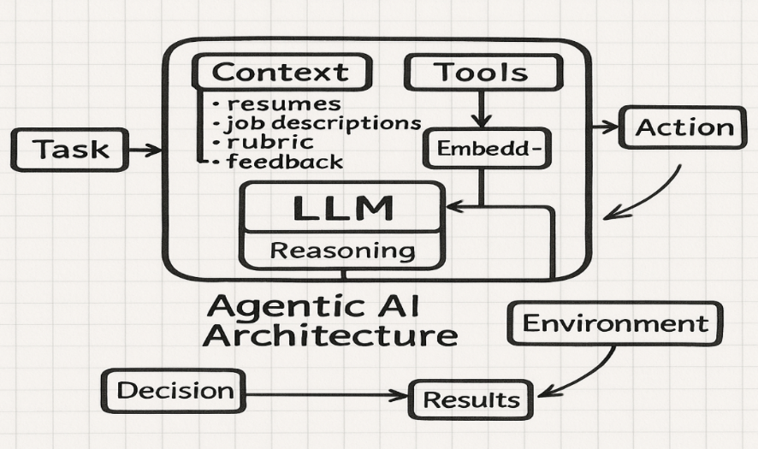
Agentic Solution Design – Architecture
A light-agent Retrieval-Augmented Generation (RAG) framework operates locally and offline as part of the Agentic architecture of the Hiring Assistant according to the diagram.
A process starts with initiating a Task through selecting a job description for evaluation.
The reasoning core which is LLM (Mistral-7B-Instruct) uses three foundational resources for operation.
Context:
The acquired data consists of processed resume data together with job description content and priority skills as stated in the rubric.
Rubric:
The rubric serves as a flexible system for skill-weight management which helps evaluators and can be adjusted through recruiter feedback.
Tools and Embeddings:
By utilizing the Sentence Transformer based semantic embeddings, an intelligent candidate job matching can be achieved with local in memory vector similarity search.
The agent retrieves some relevant context, reasons about part of it using the LLM and generates actions e.g., ranking answer candidates, suggesting rubric changes, answering recruiter queries. By acting on these Results, the environment (the recruiter interface) is performed, and results are then given to recruiters to review fit of a candidate transparently.
Informed Decisions are then made by recruiters based on ranked lists, explanations, and updated rubrics that close the feedback loop.
The Hiring Assistant exhibits adaptive, real-time behavior that is continuously goal driven from task to reasoning to action to decision and defines this as the intelligent, private, and collaborative behavior with the user.

Slide 21
Agentic Solution Design – Data Access and Grounding
Data Access
The Hiring Assistant agent retrieves information from structured local information sources.
Job Descriptions:
The PDF job descriptions reside in the job_descriptions/ folder ready for text transformation into contextual information.
Candidate Resumes:
The Hiring Assistant agent stores resumes/ folder content as PDFs and extracts information about skills and experience and education details.
Rubric File:
The rubric.json file contains a set of essential skills and weight values which enable candidate-job fit assessment.
The parsing of data occurs through PyMuPDF and uses SentenceTransformers to produce semantic
embeddings that perform similarity calculations in a locally executed offline environment.
Grounding
The agent uses a grounded, local context building approach to ensure that the reasoning, and produced responses, are accurate.
Internally we bring all these text components of the Parsed resume, job description and the rubric and combine them to form a unified session context.
In this context, the Mistral 7B instruct model is used to sort candidates or chatbot interactions.
The system is based solely on parsed and embedded local documents, which means all chatbot answers and candidate rankings are available at verifiable and trusted internal data only.
Grounding removes hallucinations through a system which limits responses of LLMs to content sourced from resumes and JDs and the rubric while blocking internet access. The system operates with resumes JDs and the rubric through static data sources although it does not access information from the internet or dynamic external sources. The design system enables the agent to base decisions on verified local data that delivers accurate and transparent and reliable assistance to recruiters and reliable support for recruiter decision-making.

Slide 22
Agentic Solution Design – Actions and Tools
Actions
The Hiring Assistant agent carries out essential off-line and local process through its modular functions.
Resume Parsing (parse_pdf_text):
This system extracts the structured text contents from job descriptions as well as resumes by performing PDF parsing operations.
Semantic Embedding and Matching (generate_embedding, compute_semantic_similarity):
The program transforms textual information into embedded forms and generates similarity values between job descriptions and candidate resumes.
Candidate Ranking (calculate_rubric_score, calculate_final_score):
Evaluation combines semantic similarity scores with rubric-based skill matching for producing skilled candidate list rankings.
Rubric Updates (update_rubric):
The chatbot system collects feedback from recruiters which then modifies the skill weights in the assessment rubric.
Answering Queries (chat_with_context):
Retrieves Using the local RAG-powered chatbot, retrieve context-based replies to recruiter inquiries and explain ranking rationale.
Tools
The agent uses the following tools to perform its actions:
PyMuPDF: Parses information from a pdf resume and jobdescriptions.
SentenceTransformers (all-MiniLM-L6-v2): Create semantic embedding.
In-Memory Vector Similarity Search: Calculates the semantic similarity between resume and job descriptions locally.
Pandas: Used for rubric-based scoring, hybrids ranking, and data management.
Mistral-7B-Instruct (Quantized Local Model): In addressing recruiting questions and permitting dynamic rubric revisions without relying on the cloud.
Streamlit: To provide a recruiter-facing online interface for job selections, rating review, and chatbot engagement.

Slide 23
Agentic Solution Design – Prototype Design and Implementation Environment
Prototype Design
The Hiring Assistant prototype uses Light-Agent RAG architecture and operates both locally and offline.
The virtual assistant obtains resumes and job descriptions uses a grounded prompt with semantic similarity and rubric scoring to rate applicants and responds to recruiter inquiries.
The protype follows to a modular design, comprising main components:
Data Layer: Parses PDFs resumes and job descriptions and loads rubric files.
Embedding and Matching Layer: Generates semantic embeddings and computes in-memory vector scores for similarity to match candidate to jobs.
Reasoning Layer: Utilizes the Mistral-7B-Instruct(quantized local model) to create replies, rank applicants, and change rubric weights via an offline chatbot.
User Interface Layer: Streamlit was used to create the user interface layer, which allows recruiters to easily submit data, examine rated applicants, and communicate with chatbots.
The architecture makes each operation (parse ➔ embed ➔ rank ➔ update) is modular, visible, locally executed, and readily scalable for future actions.
Implementation Environment
The Hiring Assistant prototype is implemented using the following environment setup:
Development Language: Python 3.x
Libraries and Frameworks:
Streamlit: Web-based recruiter interface.
PyMuPDF (fitz): PDF parsing for resumes and JDs.
SentenceTransformers: Semantic embedding generation.
Pandas: Candidate scoring, ranking, and data management.
ctransformers: Local loading and inference of the Mistral-7B-Instruct (Quantized) model.
Local Resource Management: All data (resumes, JDs, rubrics) is handled in organized local files, with no reliance on external API’s, cloud databases, or internet access.
System Requirements: Designed to operate well on CPU settings, allowing for lightweight prototype evaluation without the need for API’s, cloud databases or internet connectivity.

Slide 24
SOLUTION IMPLEMENTATION

Slide 25
Agentic Solution Implementation – Economic Feasibility of Implementing the proposed Agentic Solution
Agentic Solution Implementation – Economic Feasibility
There are three main elements that drive the proposed Hiring Assistant solution's cost efficiency including local implementation and open-source technology together with CPU-based operations.
Financial expenses for infrastructure and licensing costs vanish due to open-source technology use and CPU-based operations deployed locally.
The system encompasses multiple financial efficiency features that include:
Local, Offline Deployment:
The system operates from local infrastructure therefore users save cloud service costs and external database subscriptions as well as API fees costs.
subscriptions, and API usage costs.
Open-Source Technology Stack:
The system runs with essential components that combine Streamlit, PyMuPDF, SentenceTransformers, Pandas, and the quantized Mistral-7 B-Instruct model.
Open-source distribution provides access to free Mistral-7 B-Instruct model and Streamlit, PyMuPDF, SentenceTransformers and Pandas and additional components.
No Cloud or GPU Dependency:
The quantization mechanism provides effective standard CPU computation that reduces hardware demands.
Upgrade requirements.
Zero-Cost Initial Prototype:
The solution stays cost-efficient because testing and all developmental stages, including internal implementation, do not need any associated expenses accessible for pilot deployment.
Future Scalability Option:
The system acts locally, and the designers made it possible to integrate FAISS as well as other usable upgrades. The implementation of vector databases or cloud-based infrastructure enables enhanced processing capabilities that the system might require.
Resume volumes grow.
The Hiring Assistant presents organizations with an affordable solution that protects privacy features alongside adaptable capabilities suitable for TechCorp Solutions' needs.
Solutions' goals of innovation, operational efficiency, and data control.

Slide 26
References
Streamlit Documentation Streamlit. (n.d.). Streamlit — The fastest way to build and share data apps. Retrieved from https://docs.streamlit.io/
PyMuPDF (fitz) Documentation PyMuPDF Developers. (n.d.). PyMuPDF – PDF and other document processing library. Retrieved from https://pymupdf.readthedocs.io/
SentenceTransformers Reimers, N., & Gurevych, I. (2019). Sentence-BERT: Sentence Embeddings using Siamese BERT-Networks. Retrieved from https://www.sbert.net/
Mistral-7B-Instruct Model Mistral AI. (2023). Mistral-7B and Mistral-7B-Instruct models. Retrieved from https://mistral.ai/news/la-plateforme/
CTransformers ctransformers Developers. (n.d.). Running LLMs locally with CTransformers. Retrieved from https://github.com/marella/ctransformers
Retrieval-Augmented Generation (RAG) Concept Lewis, P., Perez, E., Piktus, A., Karpukhin, V., Guu, K., Chen, W., ... & Riedel, S. (2020). Retrieval-Augmented Generation for Knowledge-Intensive NLP Tasks. Retrieved from https://arxiv.org/abs/2005.11401
Agentic AI Concept Overview OpenAI. (2024). Agentic AI Systems: Emerging Architectures and Implications. Retrieved from https://openai.com/research/agentic-ai-systems

Slide 27
Appendix: Prototype

Slide 28
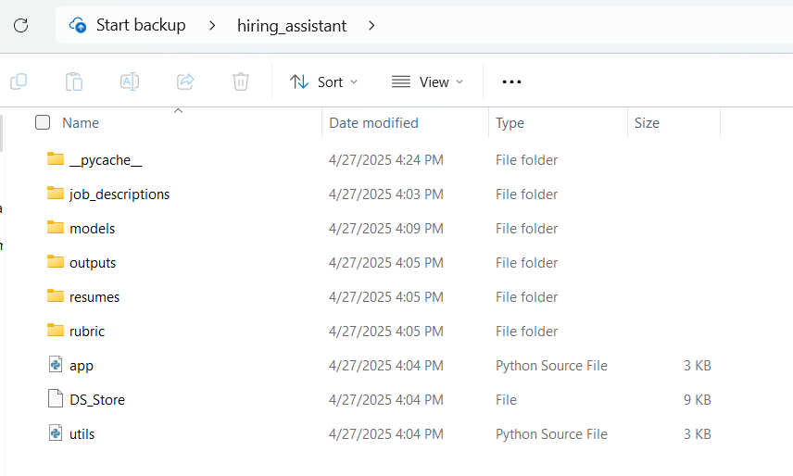
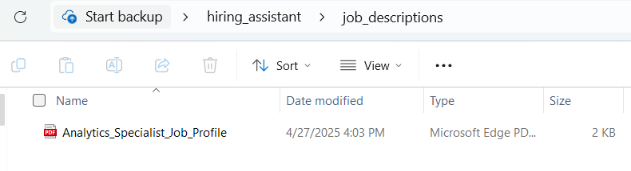
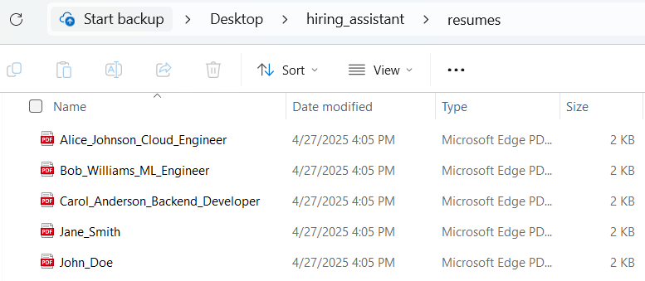
Screenshots of the configurations
Local Folder Structure
Job Description folder
Resumes Folder

Slide 29
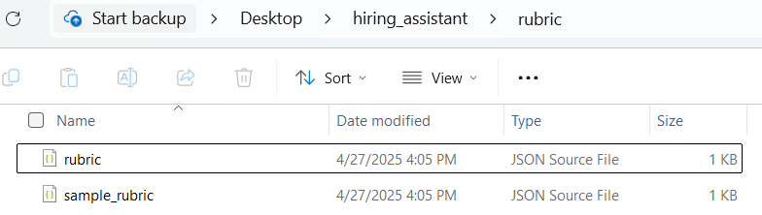
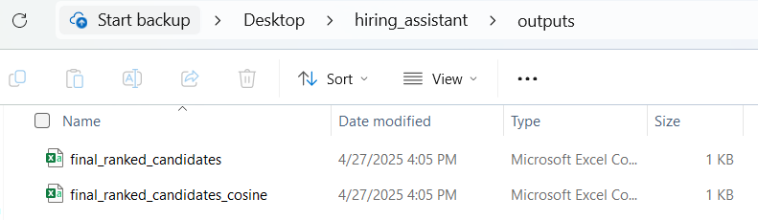
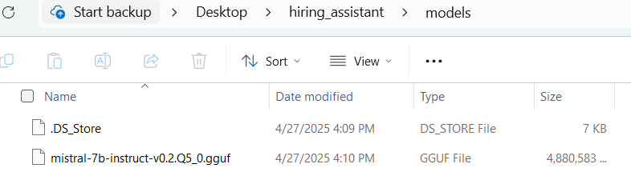
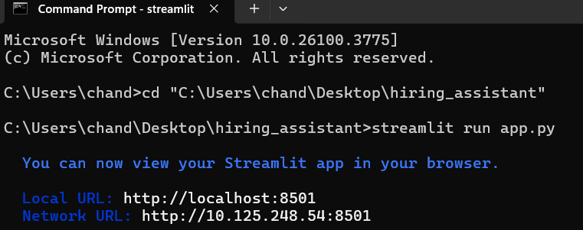
Screenshots of the configurations
Rubric Folder
Outputs Folder
Mistral 7b Model Folder
Command Prompt commands to run Streamlit app

Slide 30
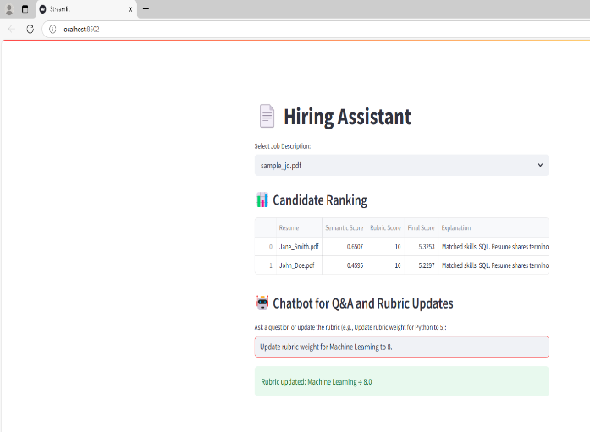
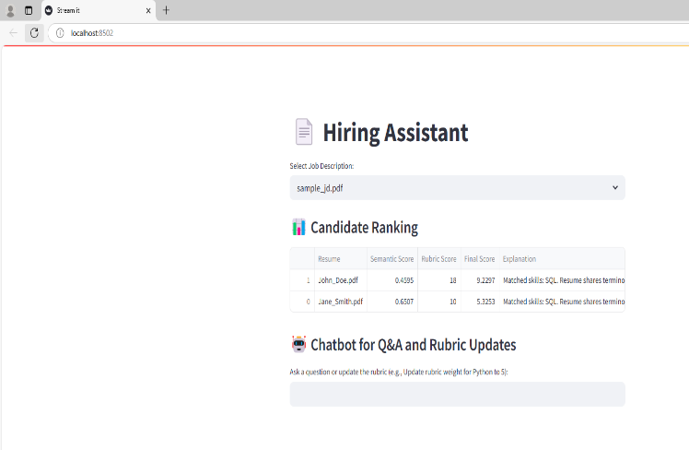
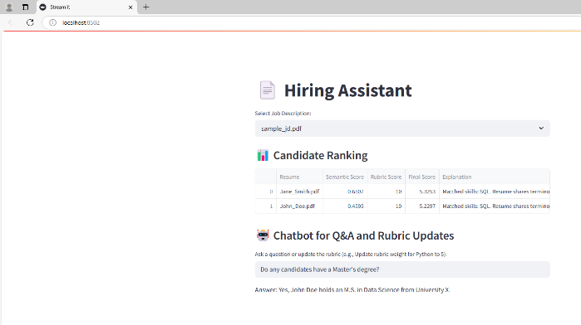
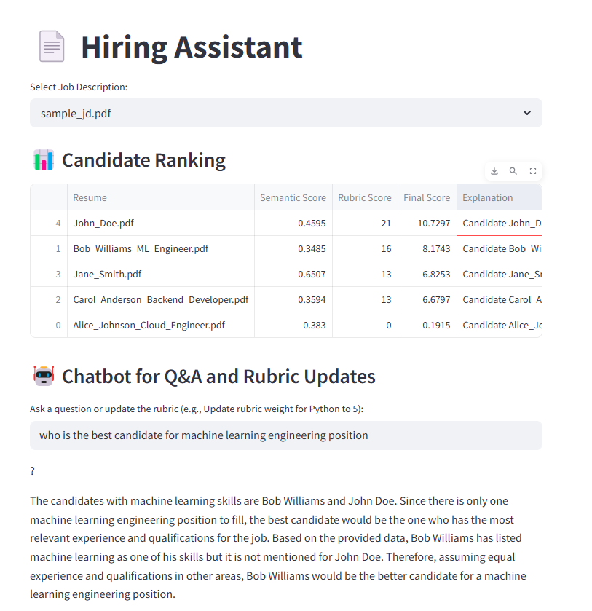
Screenshots of UI
Prompt to update rubric score
Table with updated rubric scores for the candidates
Prompt asking for a candidate with Master’s degree
Prompt asking for a best candidate for ML Engineering
position

Slide 31
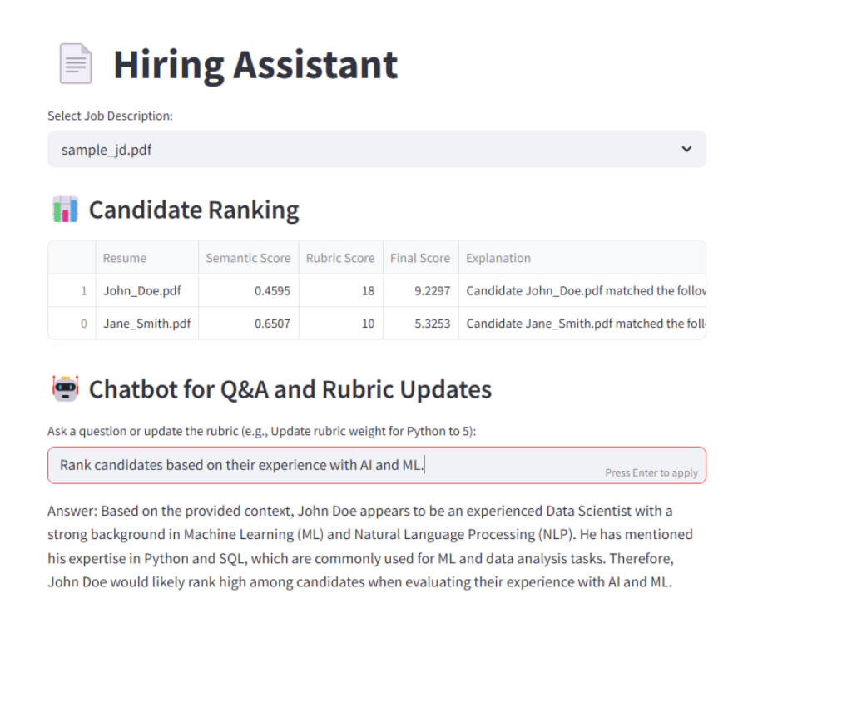
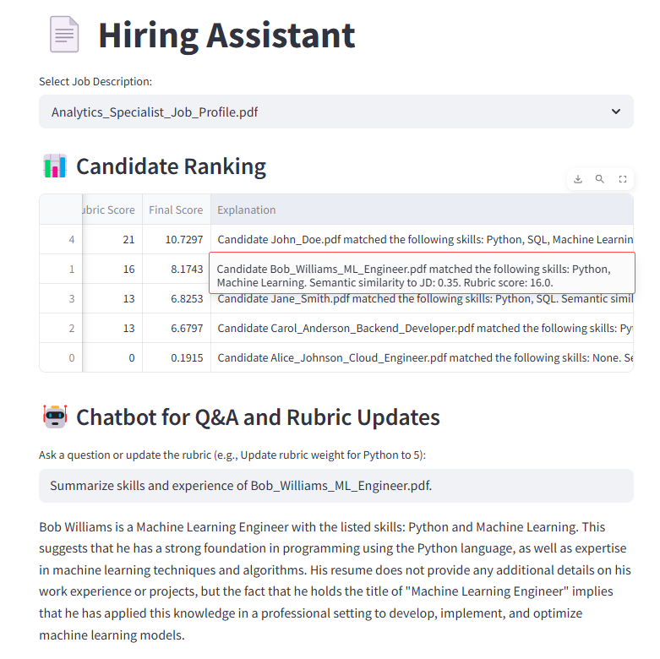
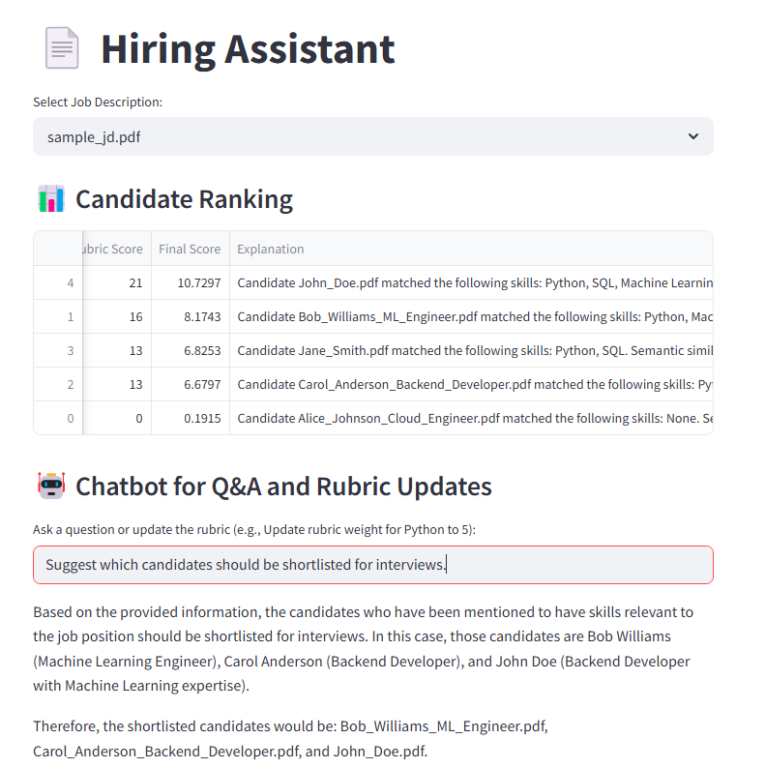
Screenshots of the UI
Prompt asking to rank candidates based on their
experience with AI and ML
Prompt asking to summarize skills and experience of
Bob Williams
Prompt asking to suggest which candidates to be
shortlisted for interviews

Slide 32
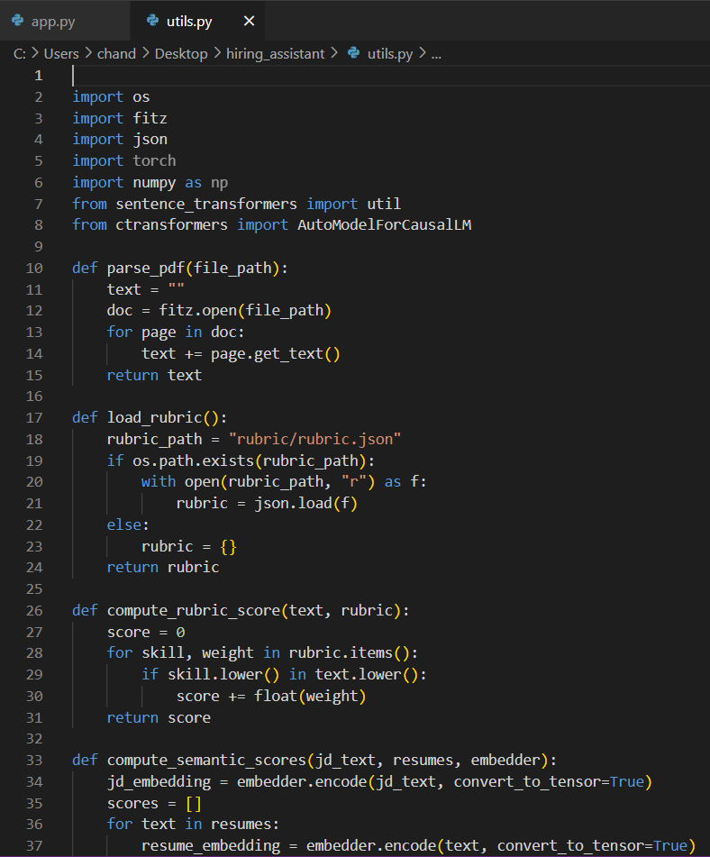
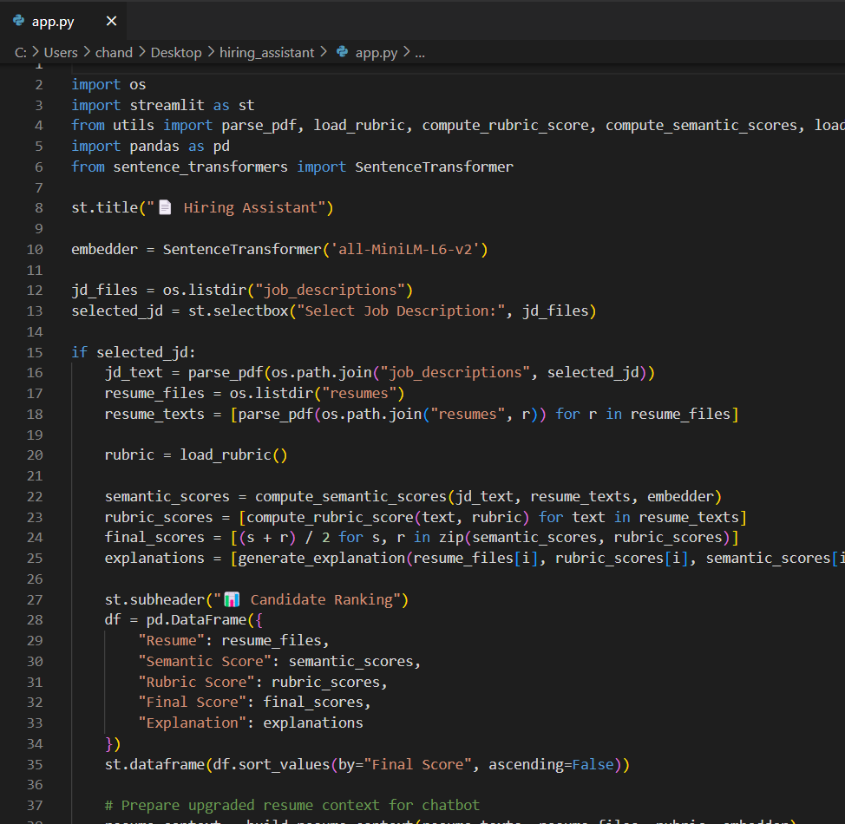

Screenshots of the code file
Utils file : Contains core functions for parsing PDFs,
generating embeddings, computing scores, and handling
rubric logic
app.py file : Hosts the Streamlit UI for uploading files,
displaying candidate rankings, and enabling chatbot
interaction
Rubric.json file with scores assigned for required skillset

Slide 33
Thank you!

